Slide 1
Sensing
Instructor: Deepak Gangadharan

Slide 2
Sensor – Energy Converter
Source: https://www.philadelphia.edu.jo/academics/kaubaidy/uploads/Sensor-Lect2.pdf
A sensor may incorporate several transducers. The last part is a direct sensor producing electrical output
Example: A chemical sensor produces electrical signal in response to a chemical reaction. It may have two parts: first one converts the energy of a chemical reaction to heat (transducer) and the other part (thermopile) converts the heat into an electrical signal
Direct sensor and Indirect Sensor

Slide 3
Types of Sensors
Output
Analog
Digital
Datatype
Scalar
Vector
Intermediate Stages
Direct sensor
Indirect sensor

Slide 4
Types of Sensors
Direct Sensor: Converts a stimulus into an electrical signal or modifies an electrical signal by using an appropriate physical effect Example: Thermocouple
Indirect Sensor: Includes one or more transducers for multiple conversion steps before a direct sensor generates an electrical output

Slide 5
Types of Sensors
Output
Analog
Digital
Datatype
Scalar
Vector
Power Requirement
Active
Passive
Intermediate Stages
Direct sensor
Indirect sensor

Slide 6
Types of Sensors
Passive Sensor: Does not need any additional energy source and directly generates an electrical signal in response to external stimulus. Most passive sensors are direct sensors as defined earlier. Example: Thermocouple, photodiode, piezoelectric sensor
Active Sensor: Requires external power for its operation, which is called an excitation signal. Example: LiDAR, GPS, infrared sensor

Slide 7
Types of Sensors
Output
Analog
Digital
Datatype
Scalar
Vector
Power Requirement
Active
Passive
Intermediate Stages
Direct sensor
Indirect sensor
Reference
Absolute
Relative

Slide 8
Types of Sensors
Absolute Sensor: Detects a stimulus in reference to an absolute physical scale that is independent of the measurement conditions Example: Thermistor
Relative Sensor: Stimulus is sensed with respect to a fixed or variable reference that is not an absolute value independent of measurement conditions Example: Thermocouple

Slide 9
Types of Sensors
Output
Analog
Digital
Datatype
Scalar
Vector
Power Requirement
Active
Passive
Intermediate Stages
Direct sensor
Indirect sensor
Reference
Absolute
Relative
Stimulus contact
Contact
Non-contact

Slide 10
Types of Sensors
Contact sensor: Requires physical contact with the stimulus Example: strain gauges, temperature sensors
Non-contact sensor: Requires no physical contact Example: optical and magnetic sensors

Slide 11
Sensor Characteristics
Static Characteristics
Range and Span
Accuracy
Resolution
Precision
Errors
Sensitivity
Linearity
Hysterisis
Dynamic Characteristics

Slide 12
Range and Span
Range Minimum and Maximum value of a physical quantity that a sensor can measure Example: A Resistance Temperature Detector (RTD) for the measurement of temperature has a range of -200 to 800˚C
Span Difference between maximum and minimum values of input measured In the above example, span of RTD = 800 – (-200) = 1000˚C

Slide 13
Accuracy and Resolution
Accuracy is the capacity of a sensor to give results close to the TRUE VALUE of the measured quantity
Measured by absolute and relative errors ABSOLUTE ERROR = RESULT – TRUE VALUE RELATIVE ERROR = ABSOLUTE ERROR / TRUE VALUE
Resolution is the minimal change of the input necessary to produce a detectable change at the output

Slide 14
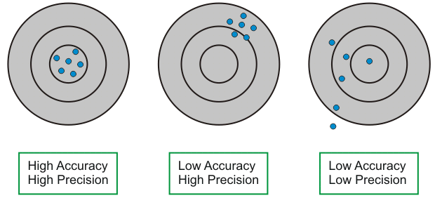
Precision
Capacity of a sensor to give same reading when repetitively measuring the same quantity under the same prescribed conditions
Source: https://www.electrical4u.com/characteristics-of-sensors/

Slide 15
Errors
Systematic Errors Due to interfering or modifying variables (e.g., temperature), loading, attenuation, etc.
Random Errors A signal that carries no information such as environmental noise
Source: https://www.philadelphia.edu.jo/academics/kaubaidy/uploads/Sensor-Lect2.pdf

Slide 16
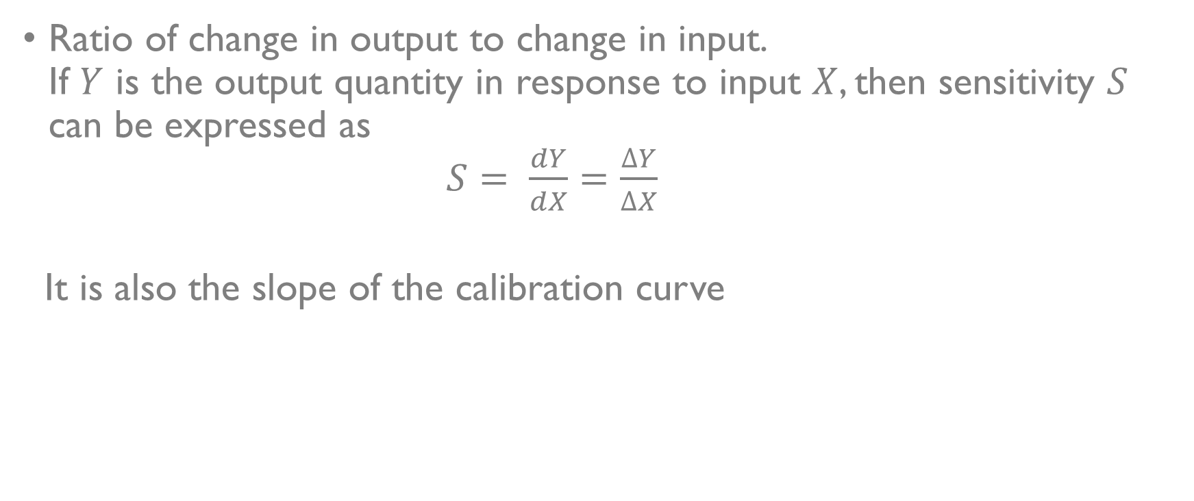
Sensitivity
Ratio of change in output to change in input. If $Y$ is the output quantity in response to input $X$, then sensitivity $S$ can be expressed as $S= \frac{dY}{dX}=\frac{∆Y}{∆X}$
It is also the slope of the calibration curve

Slide 17
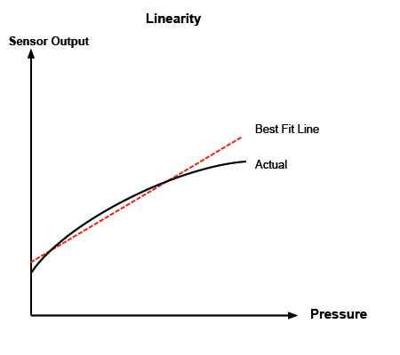
Linearity
Maximum deviation between the measured values of a sensor from ideal curve
Source: https://appmeas.co.uk/resources/pressure-measurement-notes/linearity-or-nonlinearity/

Slide 18
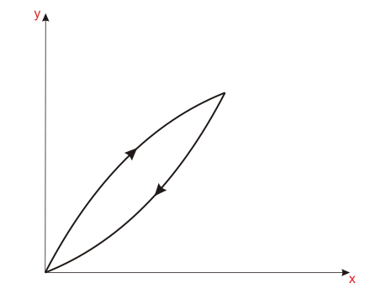
Hysteresis
Difference in output for same input when the input is reached at from different trajectories
Source: https://www.electrical4u.com/characteristics-of-sensors/

Slide 19
Dynamic Characteristics
Sensor response to a variable input is different from what is seen when the input signals are constant (described by static characteristics)
Dynamic Characteristics are determined by analyzing the response of the sensor to a family of variable input waveforms
Source: https://www.philadelphia.edu.jo/academics/kaubaidy/uploads/Sensor-Lect2.pdf

Slide 20
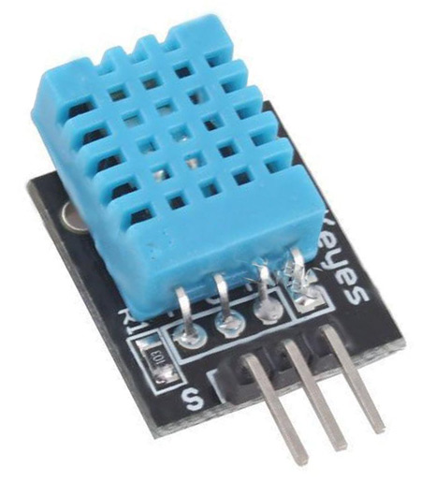
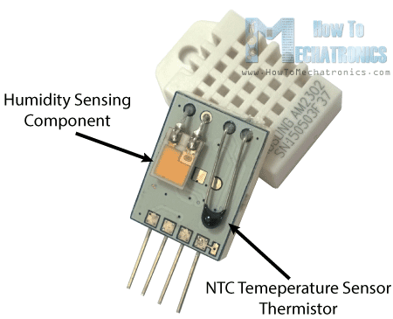
DHT11 sensor
Basic low cost digital temperature and humidity sensor
Uses capacitive humidity sensor and a thermistor to measure the surrounding air and outputs a digital signal on the data pin
Easy to use, only downside being new data can be received only once in every 2 secs
Consists of a humidity sensing component, a NTC temperature sensor (thermistor) and an IC on the back side.
Source: https://components101.com/dht11-temperature-sensor
Source: http://robocraft.ru/files/datasheet/DHT11.pdf

Slide 21
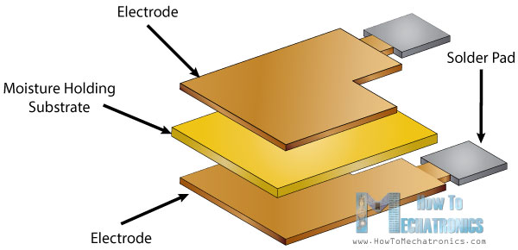
DHT11 working principle
A humidity sensing component is used which has two electrodes and a moisture holding substrate between them
Change in humidity → Conductivity of substrate changes or the resistance between the electrodes changes
IC measures and processes this change and makes it ready to read
Source: https://howtomechatronics.com/tutorials/arduino/dht11-dht22-sensors-temperature-and-humidity-tutorial-using-arduino/

Slide 22
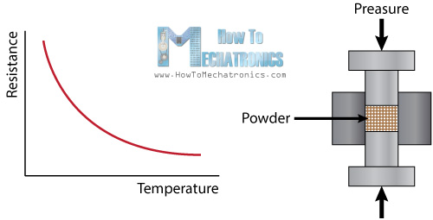
DHT11 working principle
A thermistor is a variable resistor that changes its resistance with changes in temperature
The term NTC refers to “negative temperature coefficient” → resistance decreases with increase of temperature
Source: https://howtomechatronics.com/tutorials/arduino/dht11-dht22-sensors-temperature-and-humidity-tutorial-using-arduino/

Slide 23
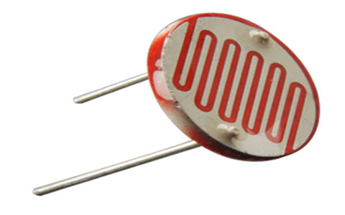
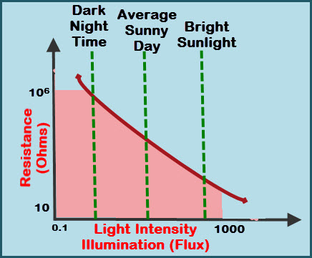
LDR sensor
A Light Dependent Resistor (LDR) or a photoresistor is a device made up of high resistance semiconductor material
Passive sensor
Resistance changes with the change in light intensity
Preferred for outdoor lighting and automatic street lighting circuits
Source: https://www.elprocus.com/ldr-light-dependent-resistor-circuit-and-working/

Slide 24
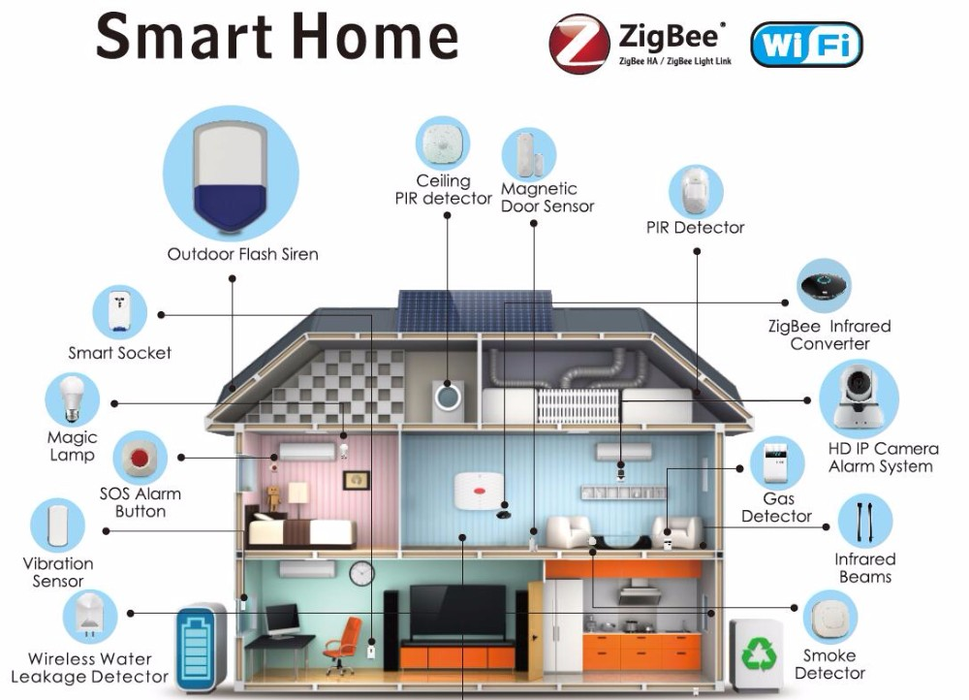
Smart Home Sensors
Source: https://www.alibaba.com/product-detail/Smart-Home-2-4G-ZigBee-Indoor_60643366019.html

Slide 25
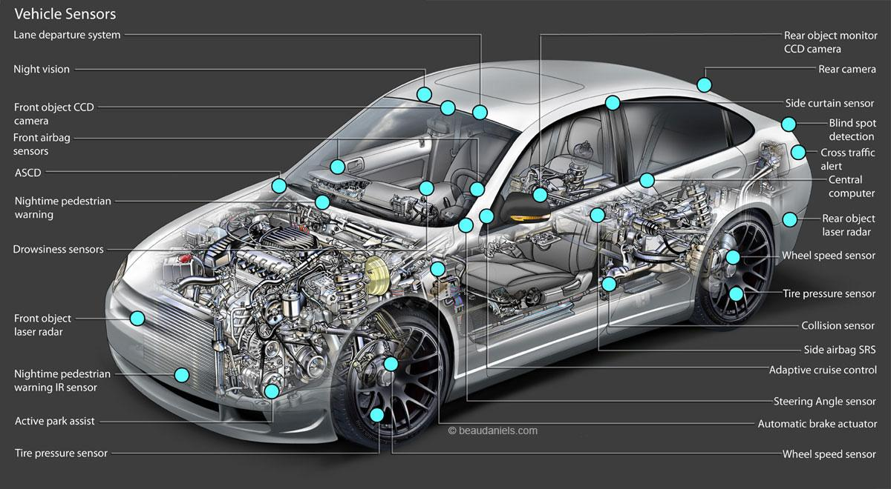
Sensors in a modern car
Source: https://carfromjapan.com/article/car-maintenance/types-of-sensors-used-in-automobile-engine/

Slide 26
Thank You

